Slide 1
OBJECT ORIENTED
ANALYSIS AND DESIGN
Ch - 4
Use Case Modeling
A study material for the students of GLS University

Slide 2
What is Use Case
A use case tells a complete story of how a user interacts with a system to achieve something useful.
"Use" = someone doing something
"Case" = a situation or goal
So, a Use Case = A situation where the system is used to achieve a goal.
Use Cases are not about how the system works inside, but what the user wants to do and how the system responds.
Use cases help in:
Understanding what the system should do
Describing user goals
Planning features in software
Creating test cases later
A Test Case is a set of steps used to check if a feature of the system is working correctly.

Slide 3
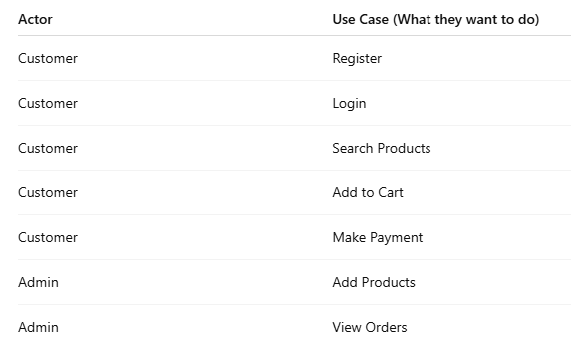
Example
A use case diagram is a visual representation that shows -
Who uses the system (Actor)
What they do (Use Cases)
The System Boundary

Slide 4
Use Case Modeling
Use Case Modeling is a simple way of understanding and writing down what the user wants from a software system.
It helps us answer:
“Who will use the system?”
“What will they do with it?”
It is part of requirements engineering — that is, figuring out what the software should do before we start building it.
Helps developers and clients understand the system clearly
Focuses on user goals instead of technical details
Acts as a blueprint before actual design and coding

Slide 5
Components of Use Case Modeling
1. System Boundary: It is a box that shows what is part of the system and what is not.
Everything inside the box = system features
Everything outside the box = external users/systems
2. Actors: An actor is anyone or anything outside the system that interacts with it.
Examples: User, Admin, External systems (e.g., Payment Gateway)
3. Use Cases: These are the goals or tasks that actors want to achieve using the system.
Examples: Login, Register, Buy Product, Generate Report
4. Relationships: These are the connections between actors and use cases or between use cases themselves.

Slide 6
Finding Actors
The actors of a system can be identified by answering a number of questions:
Who will use the functionality of the system?
Who will maintain the system?
What devices does the system need to handle?
What other system does this system need to interact?
Who or what has interest in the results of this system?

Slide 7
Finding Use-cases
For each actor ask these questions:
Which functions does the actor require from the system?
What does the actor need to do?
Could the actor’s work be simplified or made efficient by new functions in the system?
What events are needed in the system?
What are the problems with the existing systems?
What are the inputs and outputs of the system?

Slide 8
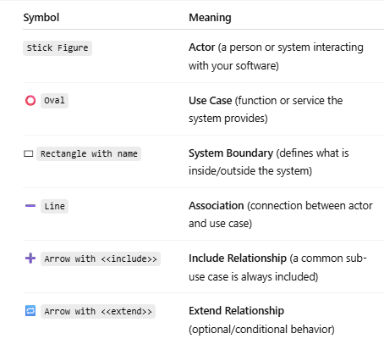
Use Case Diagram – Basic Symbols

Slide 9
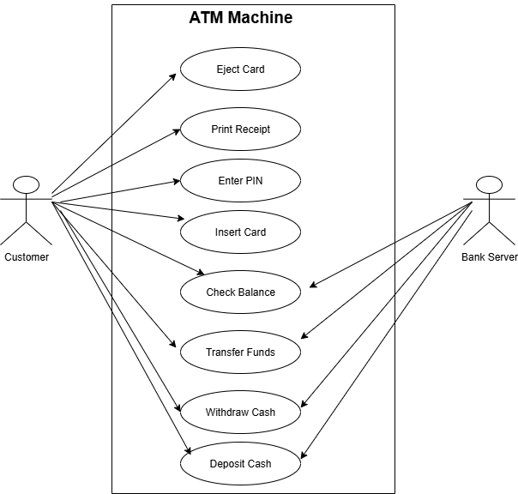

Slide 10
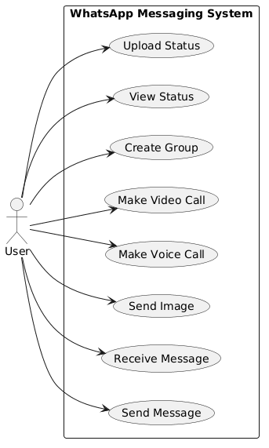

Slide 11
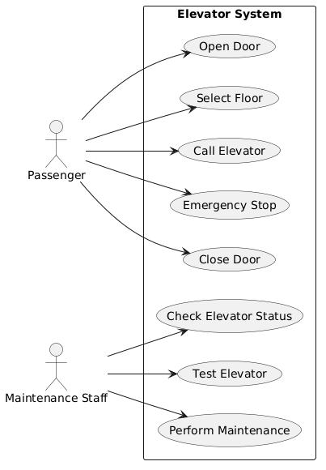

Slide 12
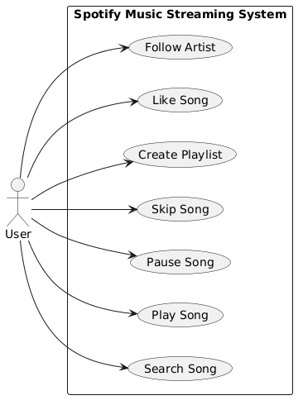

Slide 13
Task
1. Online Movie Ticket Booking: A user wants to search for movies, select a showtime, book seats, and make a payment online.
Task: Identify actors and use cases. Draw a use case diagram.
2. Ride-Hailing App (like Uber): A rider books a ride, tracks driver location, and makes payment. A driver accepts rides and completes trips.
Task: List actors and their associated use cases.
3. YouTube-like Video Platform: Users sign up, watch videos, like/share content, and upload their own videos. Admin reviews flagged videos.
Task: Identify 2 types of actors and their use cases.

Slide 14
Types of Actors
1. Primary Actor: The actor who initiates the interaction with the system to achieve a specific goal.
Goal-Oriented: They use the system to fulfill a business or user goal.
Examples:
Customer using an ATM to withdraw money
User playing music on Spotify
2. Secondary Actor (Supporting Actor): The actor that supports the system in carrying out the use case. They do not initiate the use case.
Role: Provide a service or functionality needed by the system to help the primary actor achieve their goal.
Examples:
Bank server verifying ATM transactions
Payment gateway in online shopping

Slide 15
Case Study:
The NextGen POS System

Slide 16
What is a POS System?
POS = Point of Sale
Used at billing counters in stores Combines hardware + software
Scans products, calculates bill, processes payments

Slide 17
Why NextGen POS?
Replace old cash register systems
Modern, flexible, and scalable
Works for all types of retail stores
Real-time sales and inventory integration

Slide 18
Key Business Goals
Modernization
Flexibility across stores
Real-time inventory updates
Better customer service
Secure and fast transactions

Slide 19
Actors in the System
1. Cashier -
The cashier is the primary actor.
The cashier uses the POS system to process customer purchases.
The cashier can:
Start a sale
Scan product
Enter quantity
Remove product
Calculate total
Process payment
Generate receipt

Slide 20
Actors in the System
2. Store Manager -
The manager manages products, inventory, and sales information.
The manager can:
Add product
Update product
Remove product
Check inventory
View sales
Generate reports

Slide 21
Actors in the System
3. Customer -
The customer interacts indirectly with the POS system during a purchase.
For example:
Provides products for purchase
Makes payment
Receives receipt
4. Payment Gateway -
The payment gateway is an external system.
It interacts with the POS system when the customer pays using: Card, UPI, Digital payment
5. Inventory System -
If the store has a separate inventory system, it can interact with the POS system to update stock.

Slide 22
Main Use Cases
Store Manager -
The Manager can:
Add Product
Update Product
Remove Product
View Product
Check Inventory
View Sales
Generate Sales Report
Cashier -
The Cashier can:
Start Sale
Scan Product
Enter Product
View Product Details
Update Quantity
Remove Product
Calculate Total
Process Payment
Generate Receipt
Cancel Sale
Payment Gateway -
The Payment Gateway participates in:
Process Digital Payment
Confirm Payment

Slide 23
Real-World Shopping Example
Customer brings 2 soaps, 1 shampoo
Shampoo removed by request
System calculates total
Customer pays → Change given
Receipt printed
Inventory updated

Slide 24
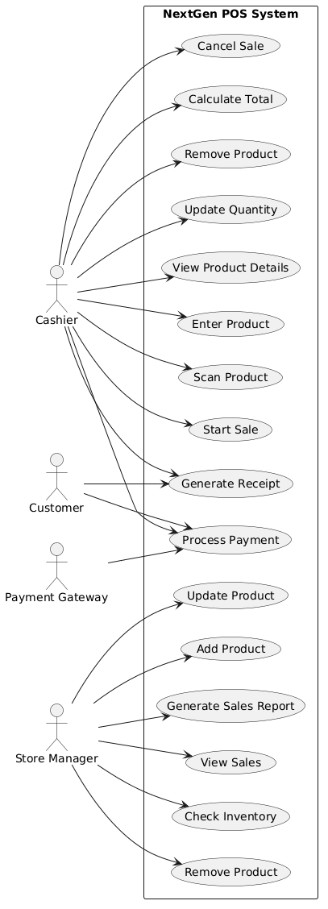

Slide 25
System Benefits
Fast & accurate billing
Auto-updated inventory
Flexible payment options
Sales analytics
Eco-friendly digital receipts

Slide 26
THANK YOU

